Slide 1
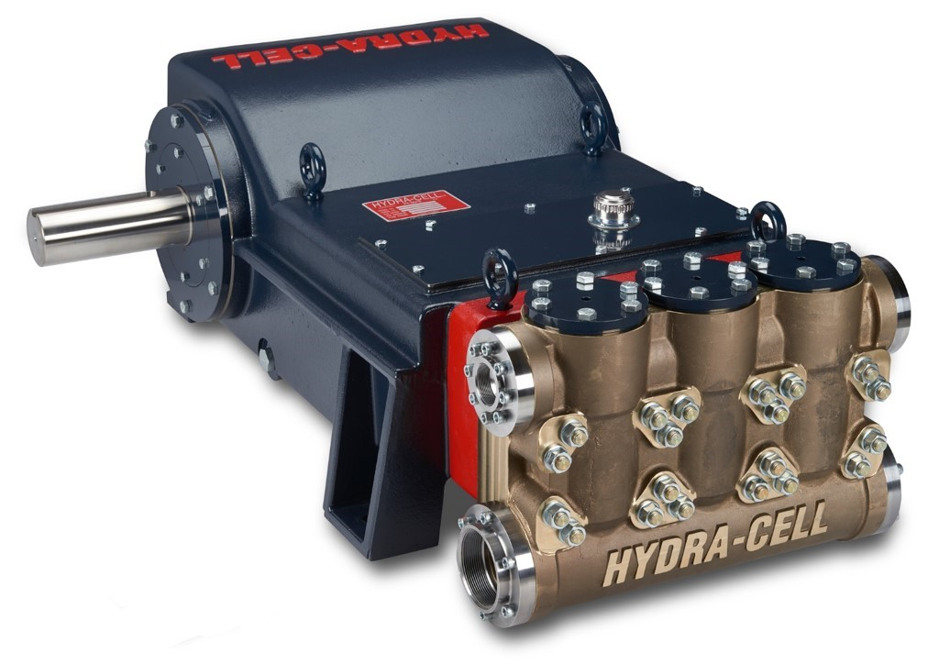


Hydra-Cell T200
March 2019
Launched model
T200 Medium pressure
Maximum pressure 241 Bar
Maximum flowrate 21m³/hr

Slide 2
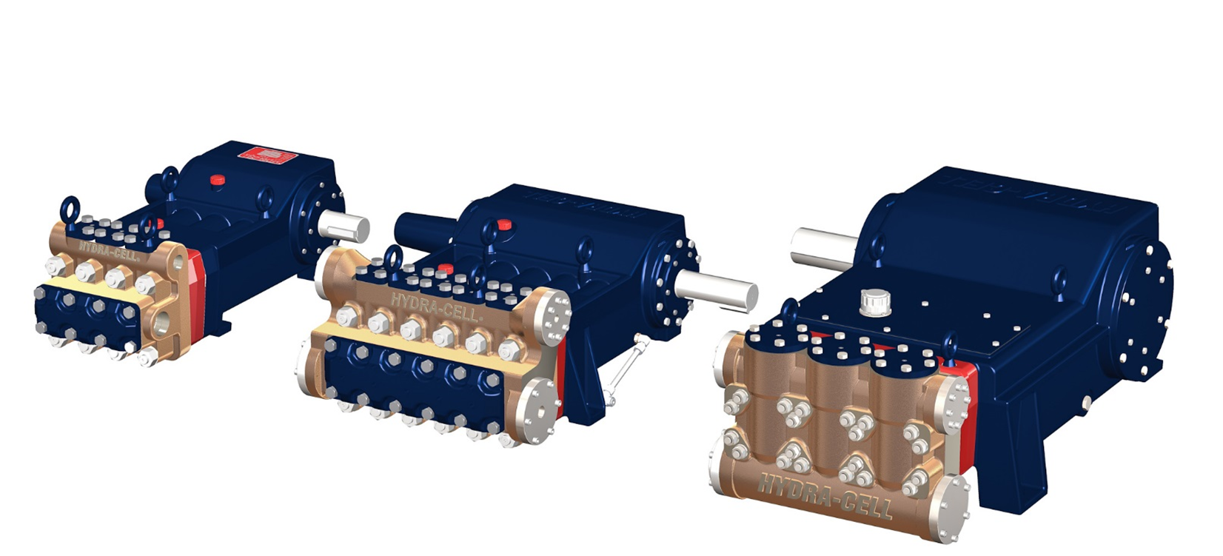
Extending the Successful T & Q series
Seal free, Packing free product range
T200
T100
Q155

Slide 3
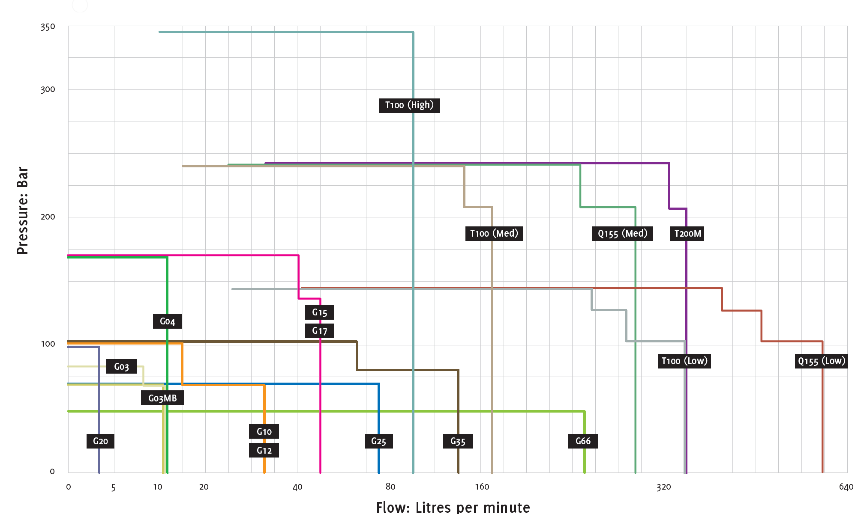
Extending the Successful T & Q series
Seal free, Packing free product range

Slide 4
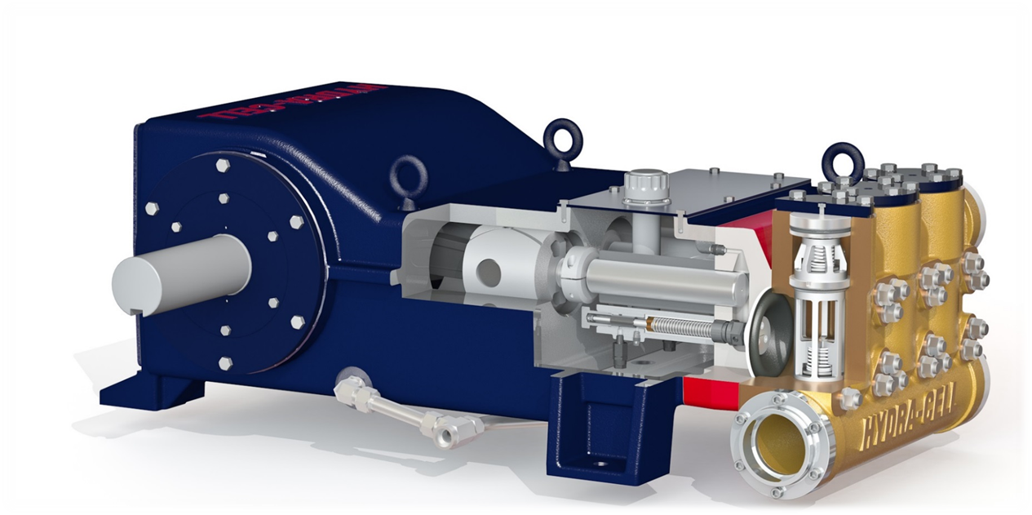
Hydraulically balanced diaphragm
Delivering a Seal free packing free design
Lowest cost of ownership

Slide 5
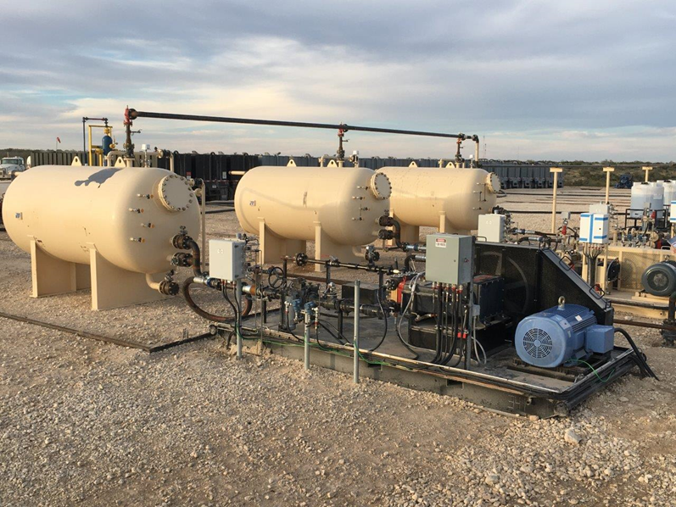
Intensive field testing
5 off T200 pumps started February 2018
Running to date (18th March 2019)
no maintenance
Application | Power fluid Injection for Jet pump
Liquid | Well produced water & Crude oil
Ambient conditions | 0 to 50⁰C
Site description | Unmanned site in desert
Inlet pressure | 14 bar (200 psi)
Discharge pressure | 240 bar (3500 psi)
Flow rate | 18m³/hr

Slide 6
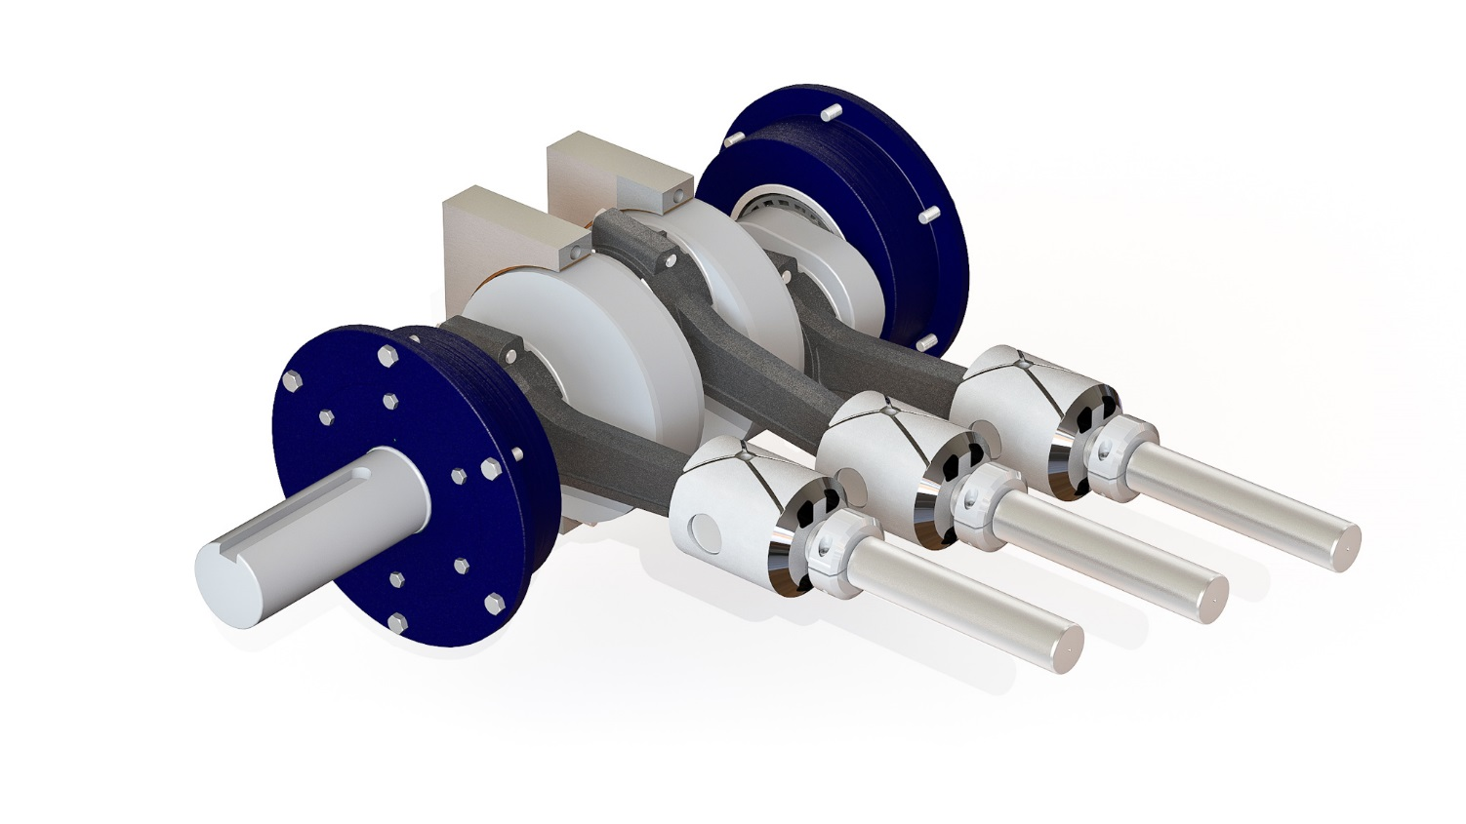
Innovative design features
Feature | Advantage
Tri-clamp plunger connection | Disconnect plungers without removing crankshaft
Austempered ductile iron crankshaft | Increased reliability over cast crankshafts at optimum cost
Spherical rollers with centre main journal bearings | Simple assembly. No shimming for endplay. No complicated measurements to align crank with pump casing/feet making motor connection simple and less critical.
Oil flow crossheads | Run at slower speeds, adds to longer running life before service

Slide 7
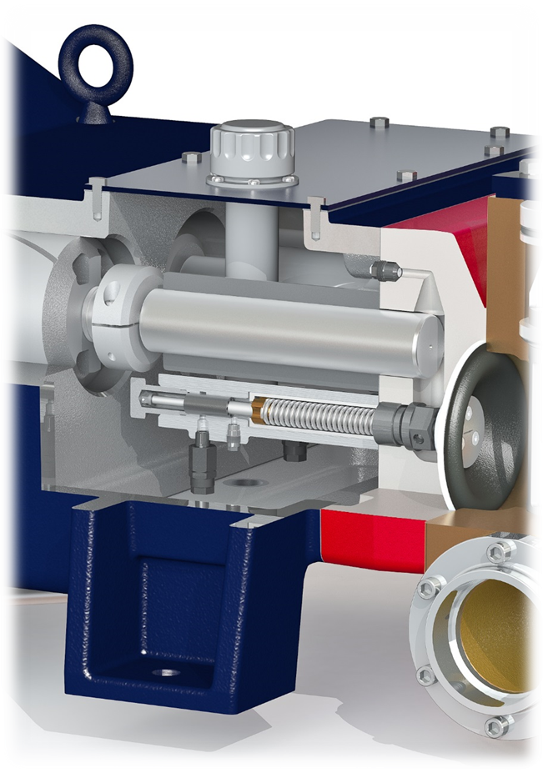
Innovative design features
Top and bottom covers
  Access hydraulic valves without removing manifold or diaphragm plate
  Change plungers and cylinders to fine tune performance
  Visual inspection of hydraulic sections without disassembling pump

Slide 8
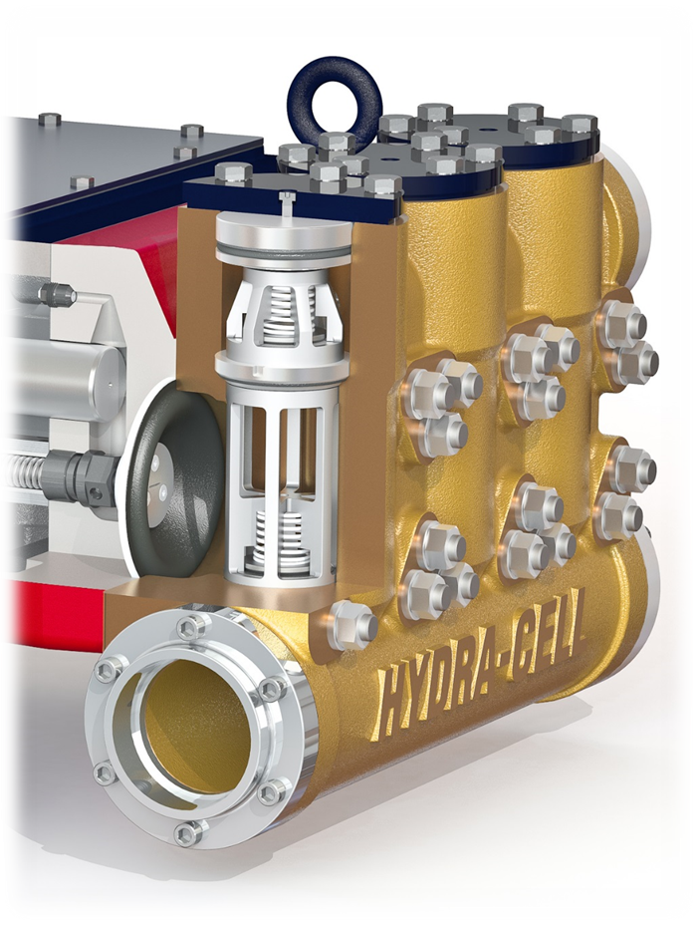
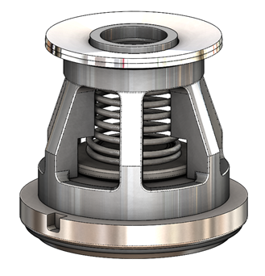
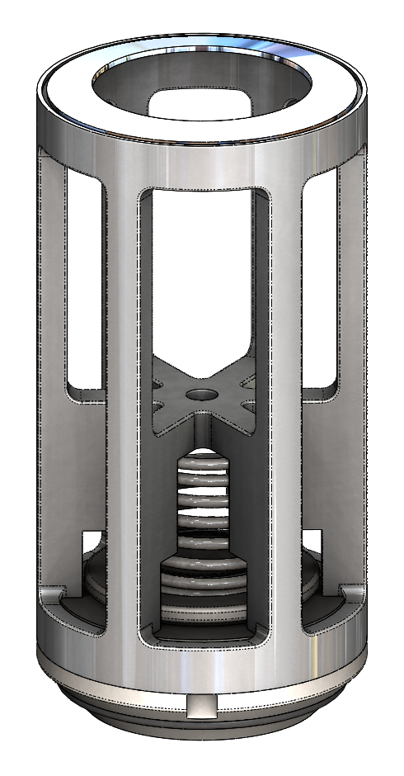
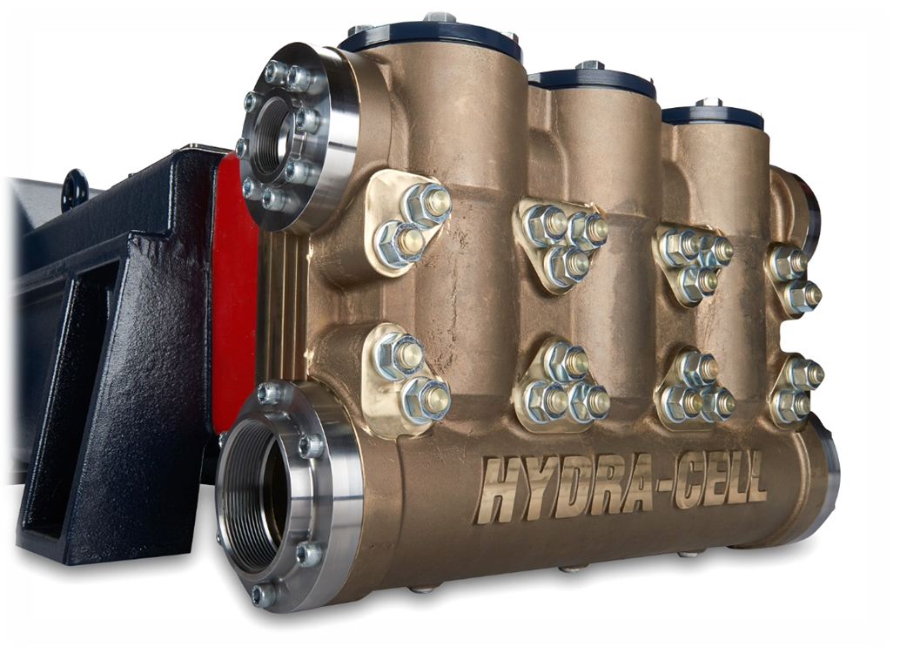
Innovative design features
Feature | Advantage
Top loading bayonet cartridge valves | No special tools required
Angled valve seats | Installed and removed by hand, no puller required
Low pressure drain ports | Easy draining of pump head & access to clear valve assembly

Slide 9
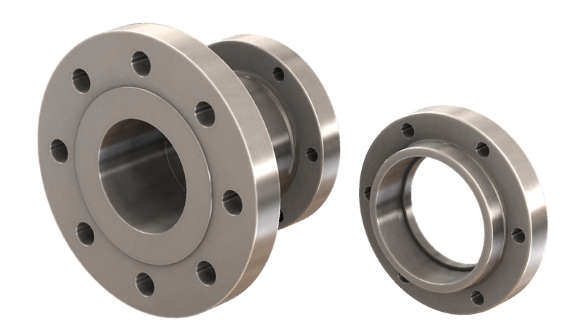
Innovative design features
Inlet Ports Weld-On: 4” / SCH. 40
4” NPT, 4” Class 300 RF ANSI
Discharge Ports Weld-On: 2” / SCH. 160
2” NPT, 2” Class 2500 RTJ ANS
Capability to weld custom flanges to weldments

Slide 10
Plunger sizes - Flow and Pressure Rating
Plunger Letter | Plunger Diameter |  | Flow capacity Maximum flowrate @ 400rpm |  |  |  | Discharge rating Maximum pressure
 | Inch | mm | GPM | BPD | LPM | M³/HR | PSI | bar
K | 2.25 | 57.2 | 95 | 3258 | 359 | 21.5 | 3000 | 206.8
M | 2.13 | 54.0 | 85 | 2915 | 321 | 19.2 | 3500 | 241.3

Slide 11
T200 value creating advantages

Slide 12
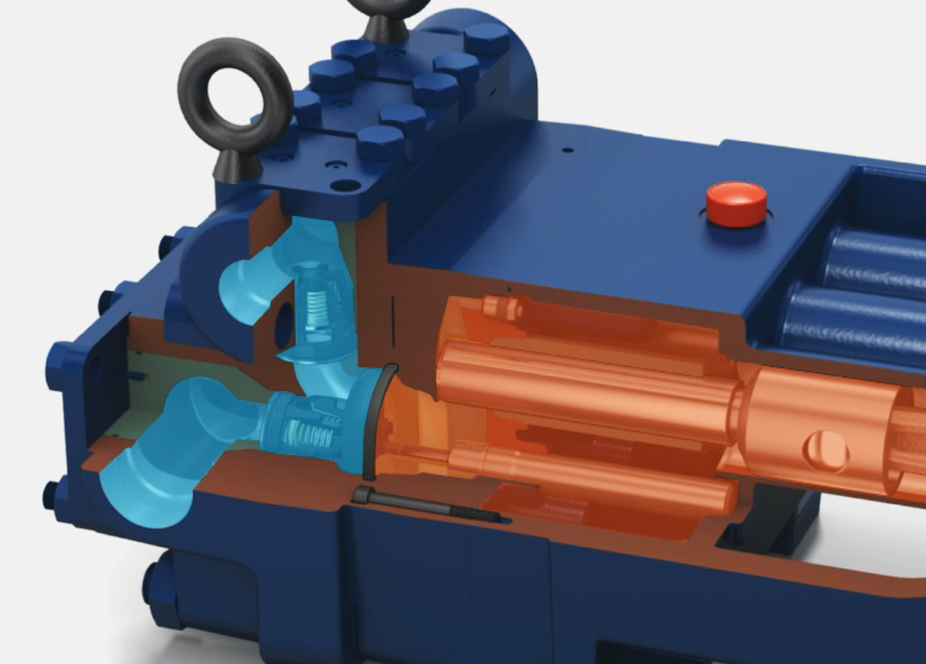
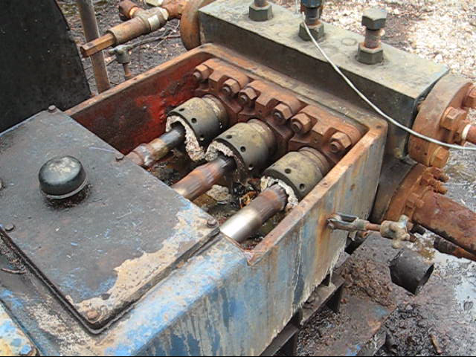
Elimination of Packing and Seal Maintenance
T200 Series
  Has no packing or seals
Plunger Pumps
  Have packing & seals which require regular maintenance

Slide 13
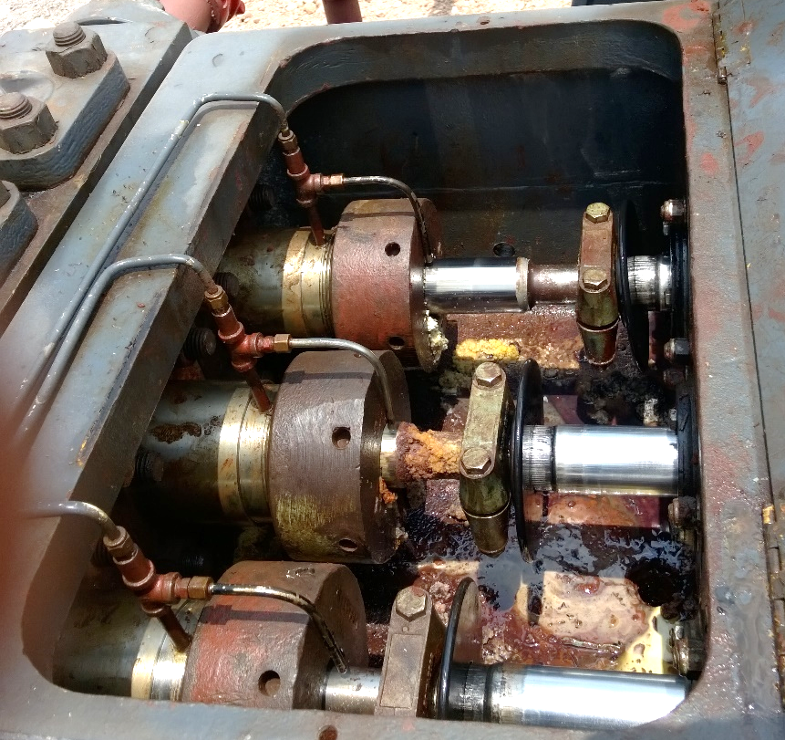
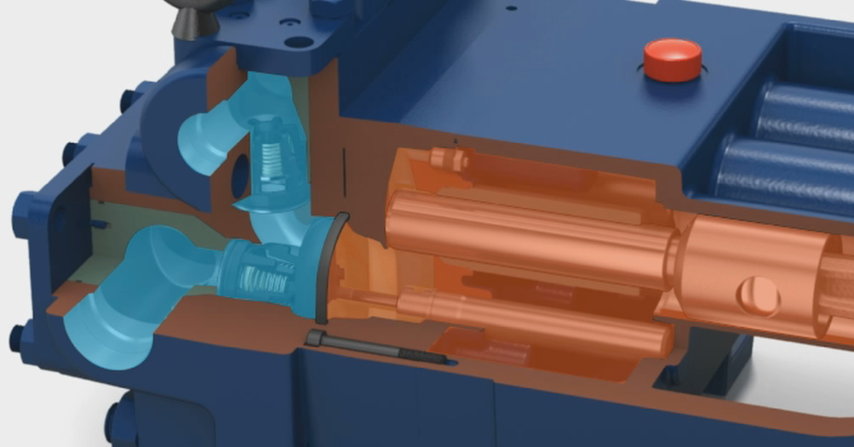
Elimination of Plunger Lubrication – Cost #1
T200 Series
  Plungers do not contact the process liquid, they are immersed in lubricating oil and require no accessory lubricators
Plunger Pumps
Require accessory lubricators add cost to each pump

Slide 14
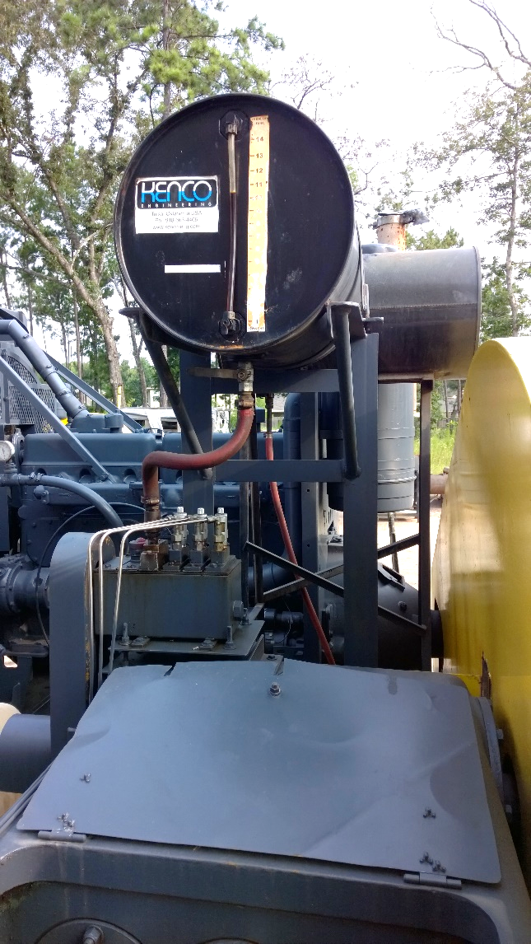

Elimination of Plunger Lubrication – Cost #2
Elimination of lubricant installation, material & maintenance, cost

Slide 15
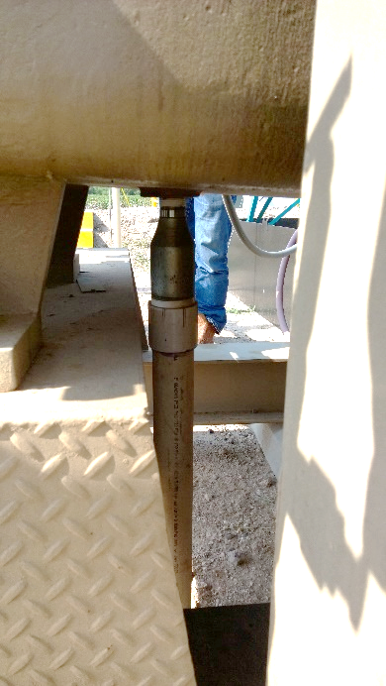

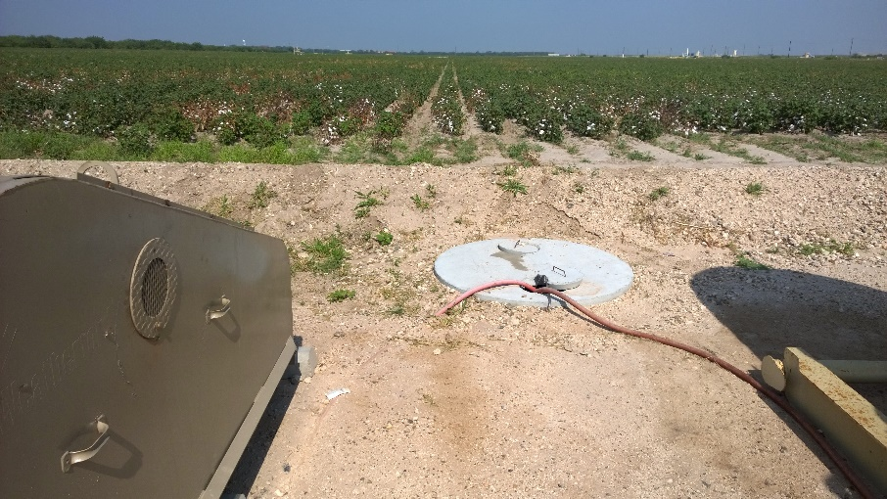
Elimination of Plunger Lubrication – Cost #3
Elimination of lubricant disposal costs, installation and maintenance
Pump lubricant drain
Underground lubricant disposal tank

Slide 16
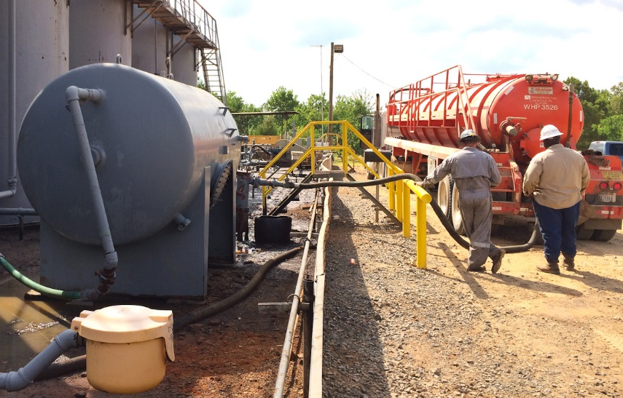
Can Run Dry Indefinitely
Running the T200 series without liquid in the pump will not damage it
This can be done for ever!!!!
If operators starve the pump by mistake no damage will occur
Tanker unloading, every chance for pump to run dry!!

Slide 17



Reduced Installation Costs
T200 Series
Simple inlet design - Minimal filtration
Plunger pumps
Often require the additional cost of a centrifugal feed pump and fine filtration to protect seals and packing
20 mesh (841 micron) strainer
50 micron strainer
T200 Series pump can self prime and even operate with suction lift inlet conditions

Slide 18
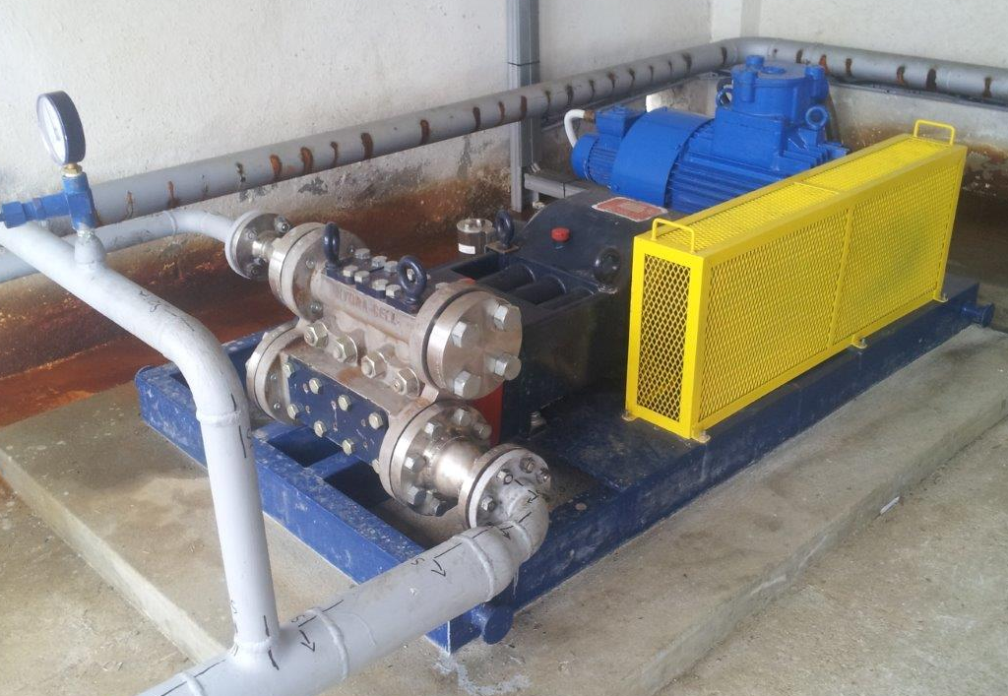
Keeps Pumped Liquid 100% Contained
Plunger pumps used in NGL or condensate transfer will leak through Packing and Seals
Leakage rate increases with time
These “non-lubricating” liquids cause wear to progress rapidly damaging the pump
When pumping liquids such as NGLs, the T200 series keeps the NGL 100% contained
Many 1000’s of the smaller Hydra-Cell pumps have been used pumping NGLs and condensates for many years
T Series pump on gasoline distribution duty
Installed in 2015. As of March 2019 no maintenance
Zero environmental damage

Slide 19
Less Frequent Crank Oil Change
All Seals and Packing leak even when new. This results in the pumped liquid contaminating the crank oil requiring frequent changes
The T200’s Seal-Less design means that the pumped liquid and crank oil are completely separated resulting in no contamination of the crank oil and much longer periods before changing.

Slide 20
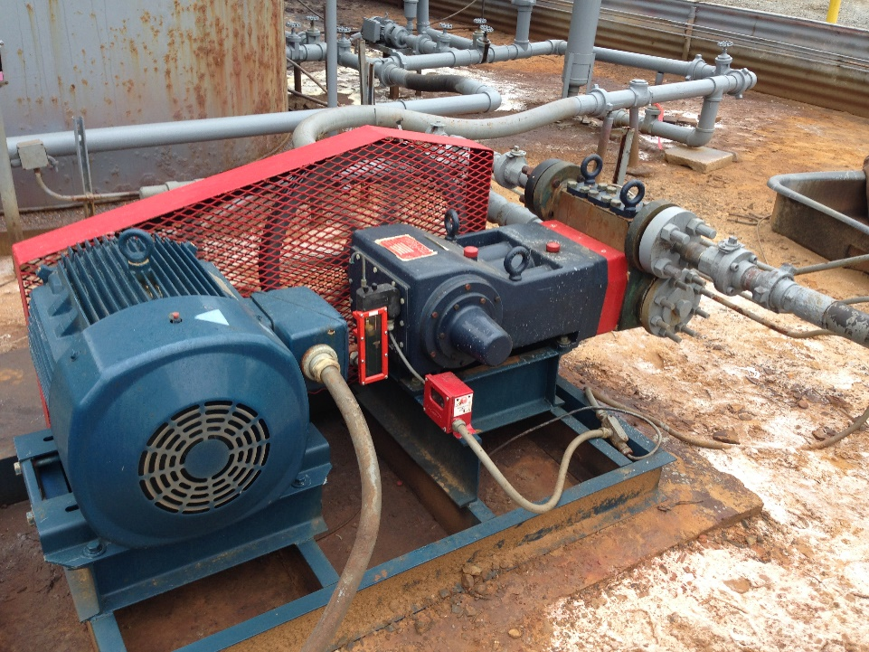
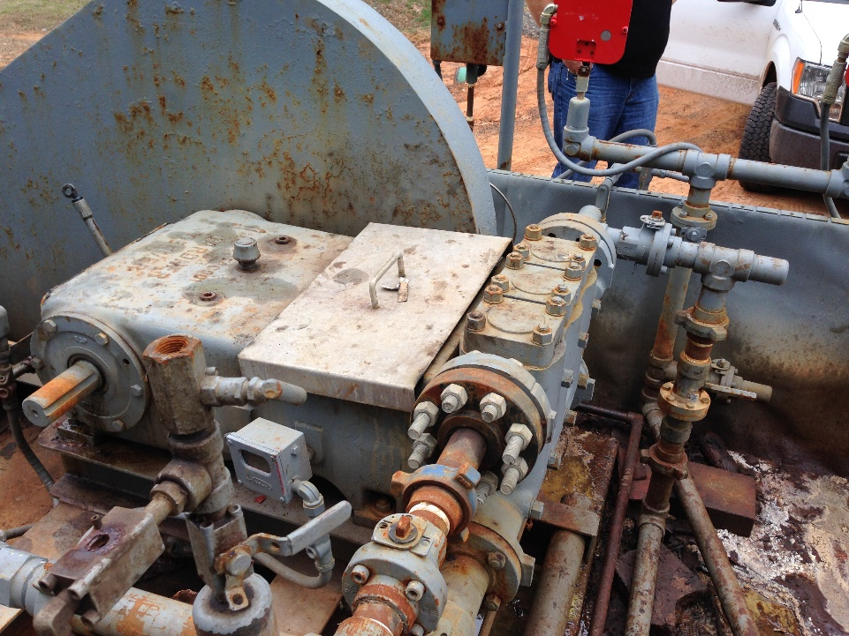
3-Year Operating Cost Comparison
Application: Produced Water Re-Injection
Location: Addison Texas US
Hydra-Cell T100
Plunger Pump
The following slide shows a breakdown of operating costs comparing the T100 pump to a plunger pump

Slide 21
T & Q Series Advantages
3-Year Life Cycle Cost Comparison
Attributes | Hydra-Cell T Series | Plunger Pump
Crank Oil Replacement | Frequency: Every 3 months Material Cost: $155 Labour Cost: 0.5 hours x $50 = $25 Total Cost: $2,160 for 3 years | Frequency: Every 3 months Material Cost: $155 Labour Cost: 0.5 hours x $50 = $25 Total Cost: $2,160 for 3 years
Packing Replacement | No packing | Frequency: 1 per month Material Cost: $600 Labour Cost: 4 hours x $50 = $200 Total Cost: $28,800 for 3 years
Plunger Replacement | Plunger does not sit in process liquid. No Plunger change required in 3 years. 10 years plus life | Frequency: Every year Material Cost: $4,000 Labour Cost: 8 hours x $50 = $400 Total Cost: $13,200 for 3 years
Valve Set Change | Frequency: Every 2 years Material Cost: $1,900 Labour Cost: 1 hours x $50 = $50 Total Cost: $2,925 for 3 years | Frequency: Every 1 year Material Cost: $900 Labour Cost: 2 hours x $50 = $100 Total Cost: $3,000 for 3 years
Diaphragm Change | Frequency: Every 2 years Material Cost: $790 Labour Cost: 1 hours x $50 = $50 Total Cost: $1260 for 3 years | No diaphragms
Total Cost 3 years | $6,345 | $47,160
This customer is extremely happy with the cost reduction and in the process of changing
all the plunger pumps for Hydra-Cell T100 pumps.

Slide 22
T200 Hydra-Cell pump creating value

